Slide 1
Merging vs Cherry Picking
Compiled and Presented by:
Byron Knox and Thlokomelo Hlomuka
Date: 29 February 2022

Slide 2
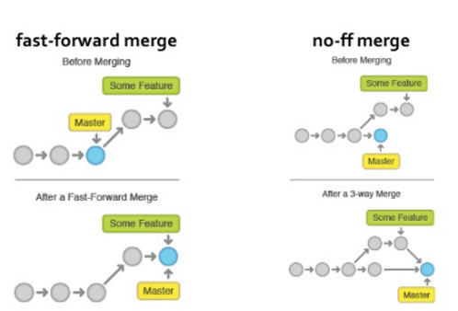
Background: Merging
What is merging? Process of taking two branches and merging them. Types of Merging Fast Forward Combining commits from two branches by moving the head. Non-Fast-Forward: Recursive/ORT (Sort) Combining commits from two branches by creating a new merge commit.

Slide 3
>>merge Demo<<

Slide 4
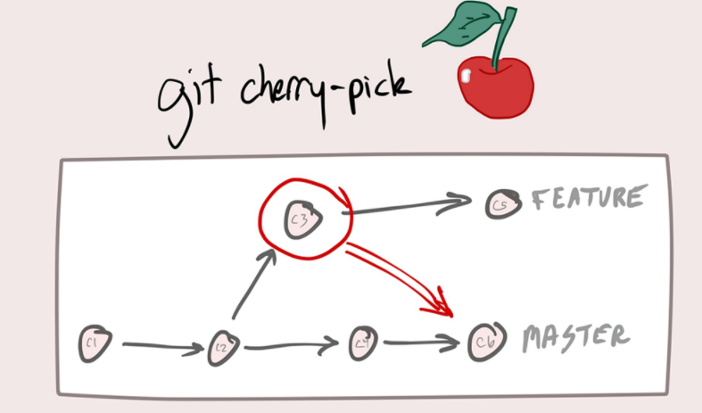
Background: Cherry Picking
What is Cherry Picking? Adding a specific commit to a specific branch, therefore creating copies of commits (duplicates).

Slide 5
>>cherry picking Demo<<

Slide 6
Thank you!

